Slide 1
CAPSTONE PROJECT -Integrated Electrical Maintenance Equipment Analysis (2018-2021)

Slide 2
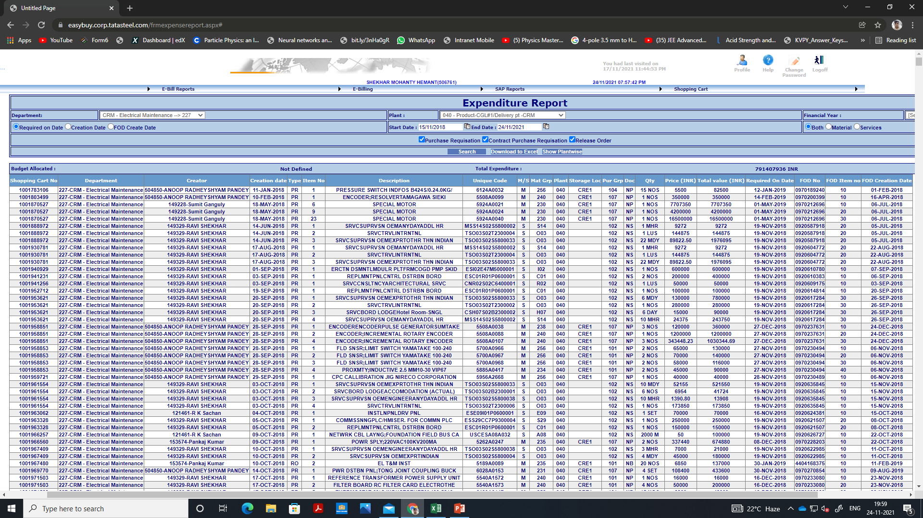
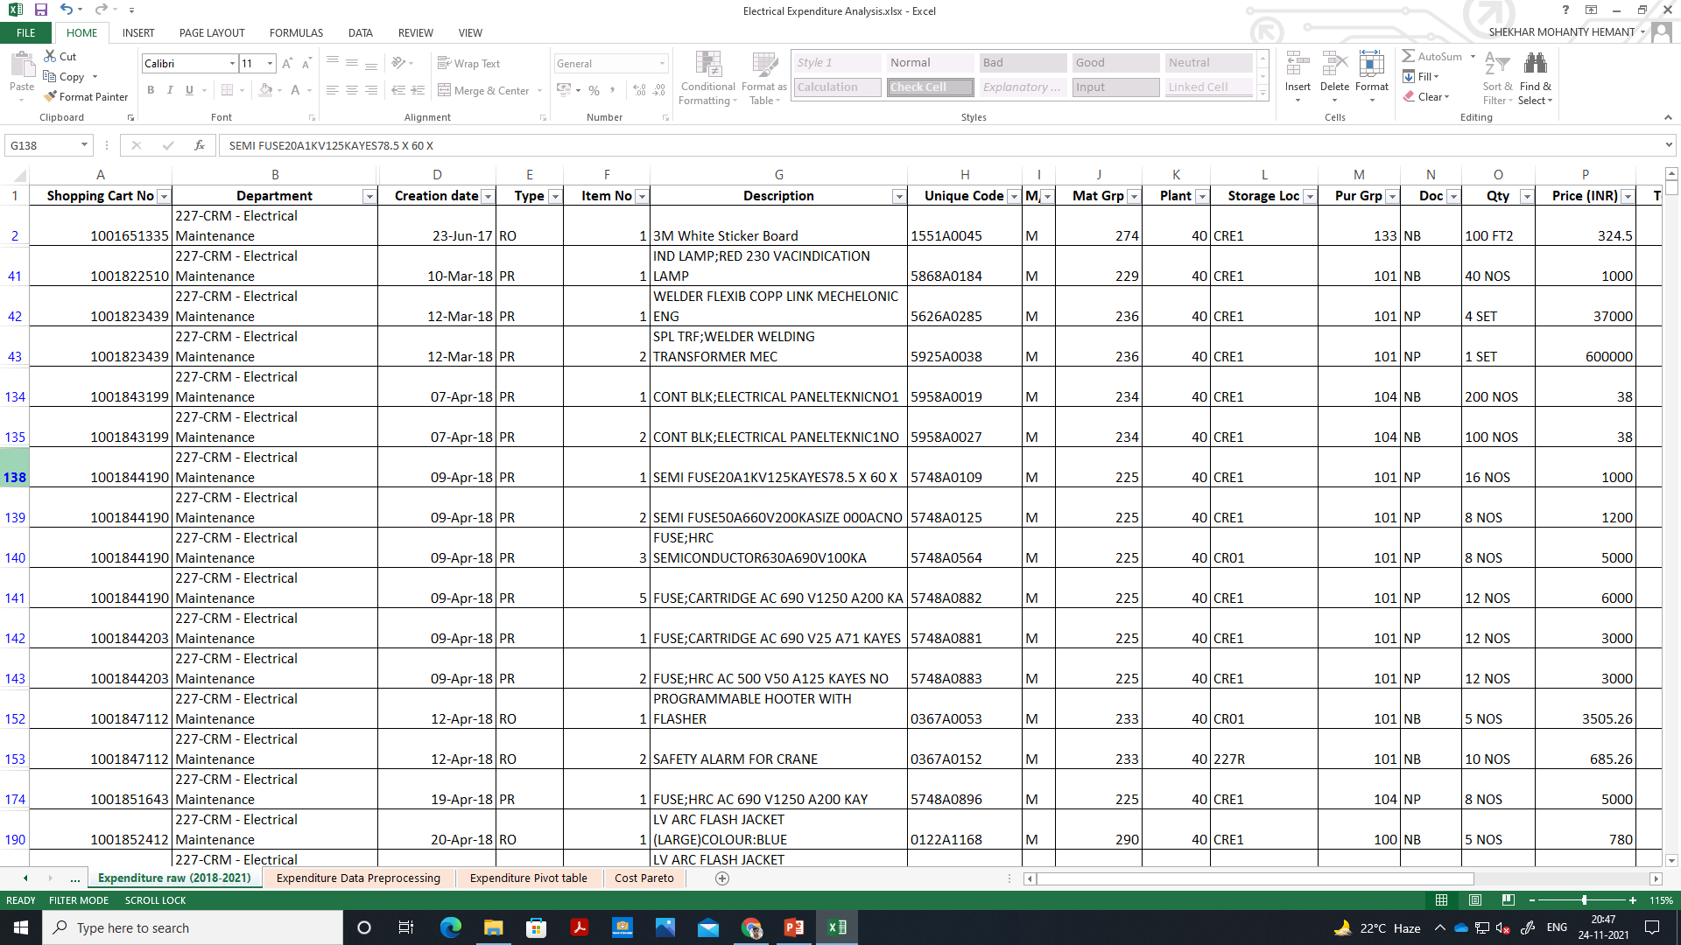
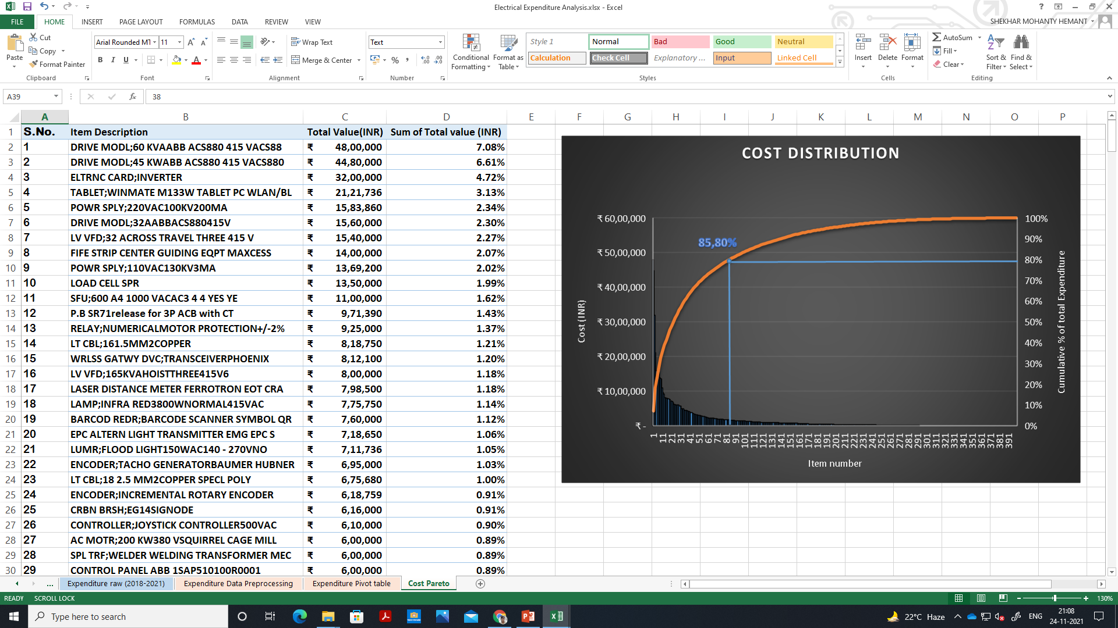
Data- Collection
RAW DATA FROM ERP SYSTEM
PRE-PROCESSING
CONSOLIDATED IN PIVOT TABLES
Raw data from ERP system of Expenditure on Electrical maintenance equipments over past 3 years of my department was exported in excel, pre-processing includes filtering data for my section(F&D) and creating some useful metrics using excel formula.

Slide 3
Analysis (Graphs and Charts) and interpretation

Slide 4
Analysis (Graphs and Charts) and interpretation

Slide 5
INSIGHTS AND RECOMMENDATION

